Slide 1
SC2001 PROJECT 2
IVAN LIM, JUSTIN CHUA, CHEW YOU CHUN

Slide 2
TABLE OF CONTENTS
01
02
Dijkstra's Algorithm
Analysis
(Adjacency Matrix)
03
04
Analysis
(Adjacency List)
Comparison
(Matrix vs List)

Slide 3
01
DIJKSTRA'S ALGORITHM

Slide 4
DIJKSTRA'S ALGORITHM
Greedy algorithm
Finding the shortest path between nodes in a graph
Uses Priority Queue

Slide 5
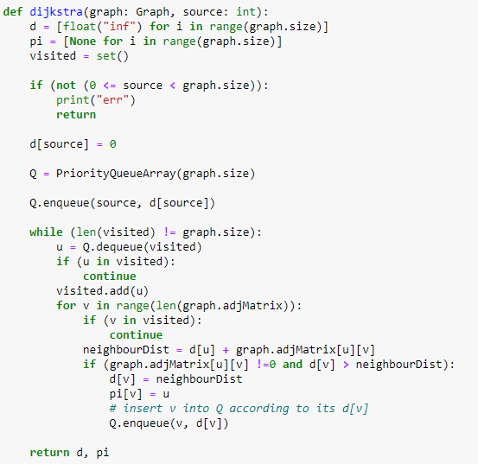
DIJKSTRA'S ALGORITHM IMPLEMENTATION
Initialize d, pi, and visited
2. Set source distance to be 0
3. Push source vertex into PQ
4. Loop through all vertices, pop closest vertex
5. Loop through neighbours
6. Update if shorter distance
7. Return when all nodes have been visited

Slide 6
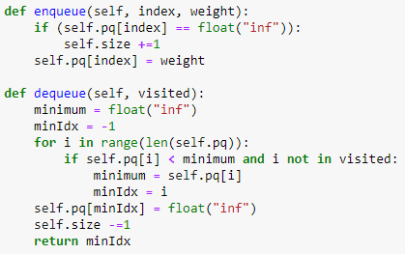
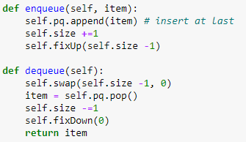
PRIORITY QUEUE IMPLEMENTATION
Array
Heap
O(1)
O(logn)
O(n)
O(logn)

Slide 7
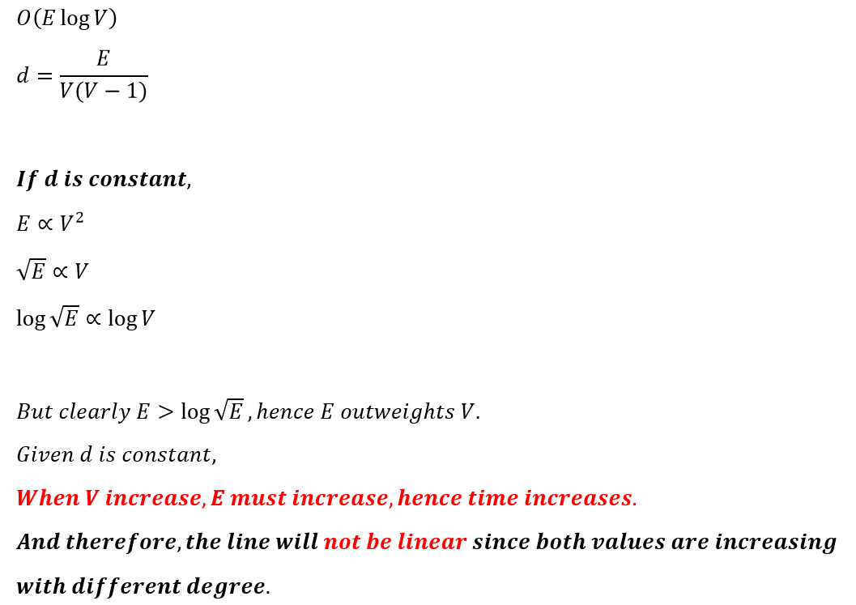
DENSITY
Ratio of edges present over all possible edges

Slide 8
02
ANALYSIS
(ADJACENCY MATRIX)

Slide 9
TIME COMPLEXITY ANALYSIS
(ADJACENCY MATRIX)
O(1)
O(V*V)
O(e)
O(V*e)

Slide 10
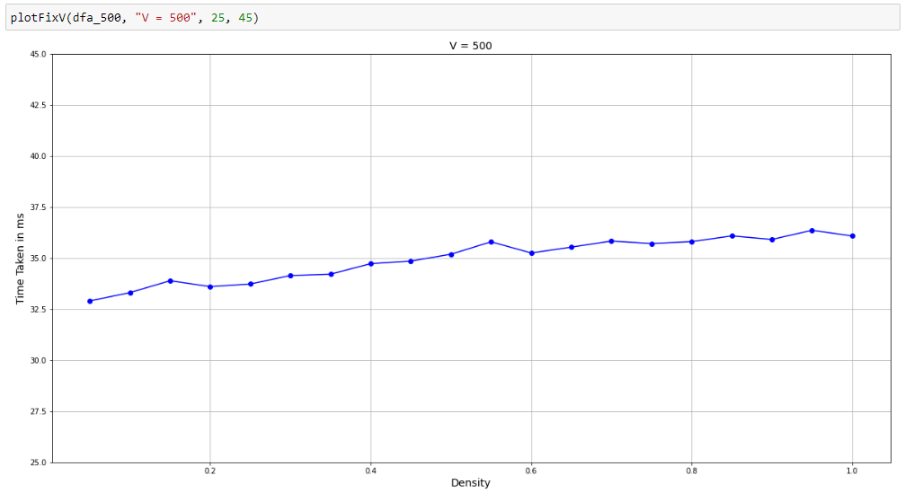
ANALYSIS I: DIFFERENT DENSITY WITH CONSTANT V
ANALYSIS I
(ADJACENCY MATRIX)
O(V^2 + Ve + 1)
Overall Time Complexity
: O(V^2)

Slide 11
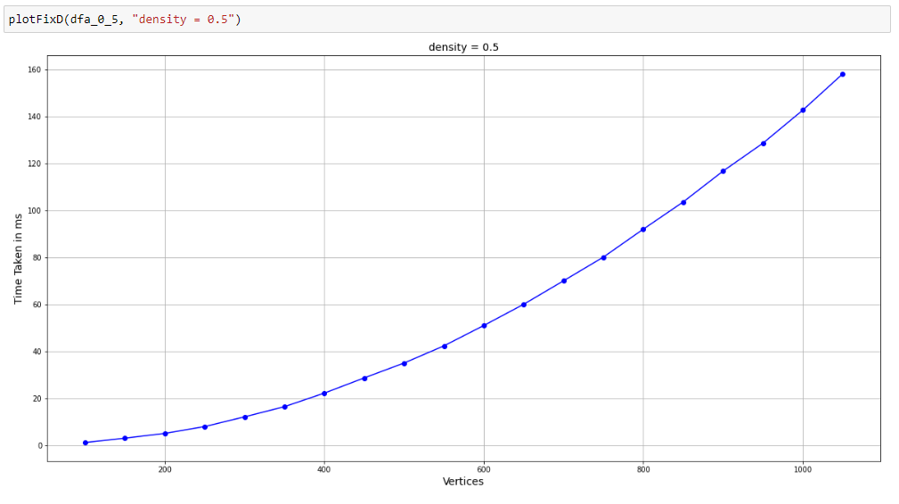
ANALYSIS II: DIFFERENT V WITH CONSTANT DENSITY
ANALYSIS II
(ADJACENCY MATRIX)

Slide 12
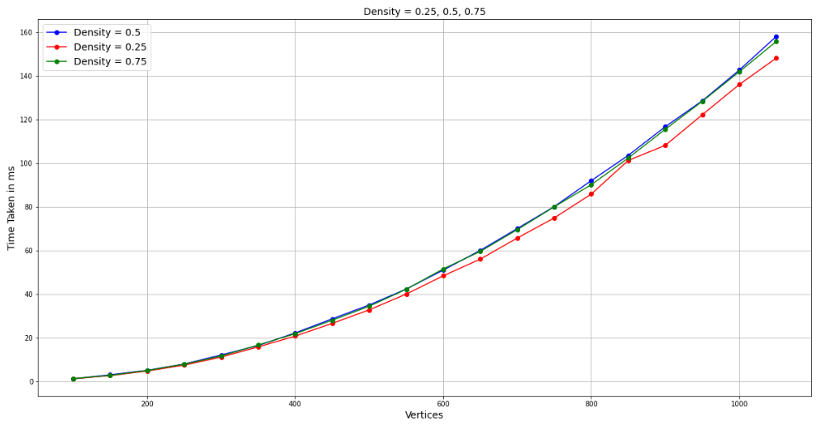
ANALYSIS II: DIFFERENT V AND DENSITY

Slide 13
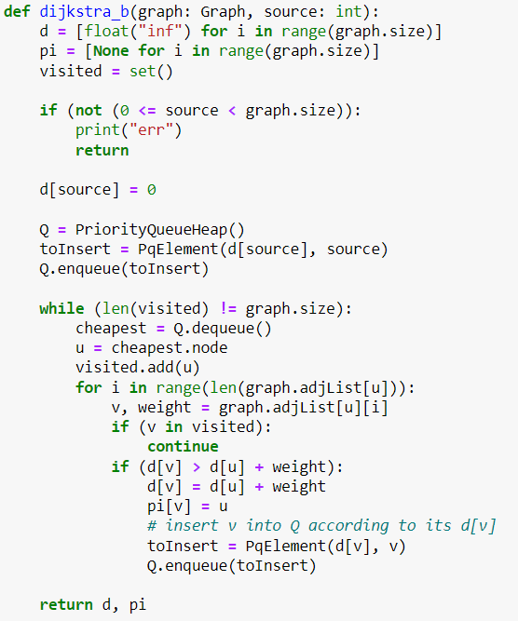
IMPLEMENTATION
(ADJACENCY LIST)

Slide 14
TIME COMPLEXITY ANALYSIS
(ADJACENCY LIST)
O(log v)
O(Vlog V)
O(e)
O(Velog V)

Slide 15
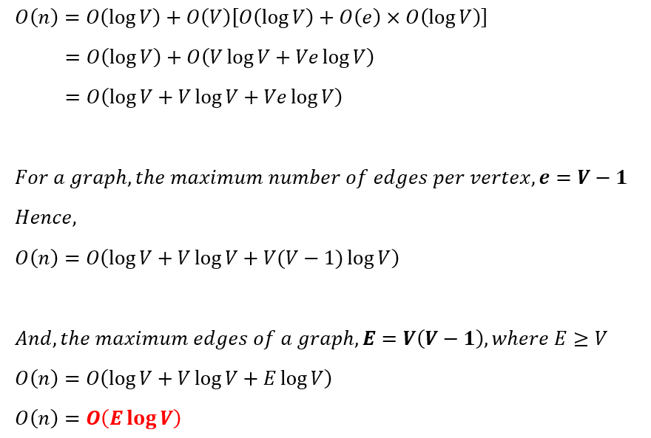
TIME COMPLEXITY ANALYSIS
(ADJACENCY LIST)

Slide 16
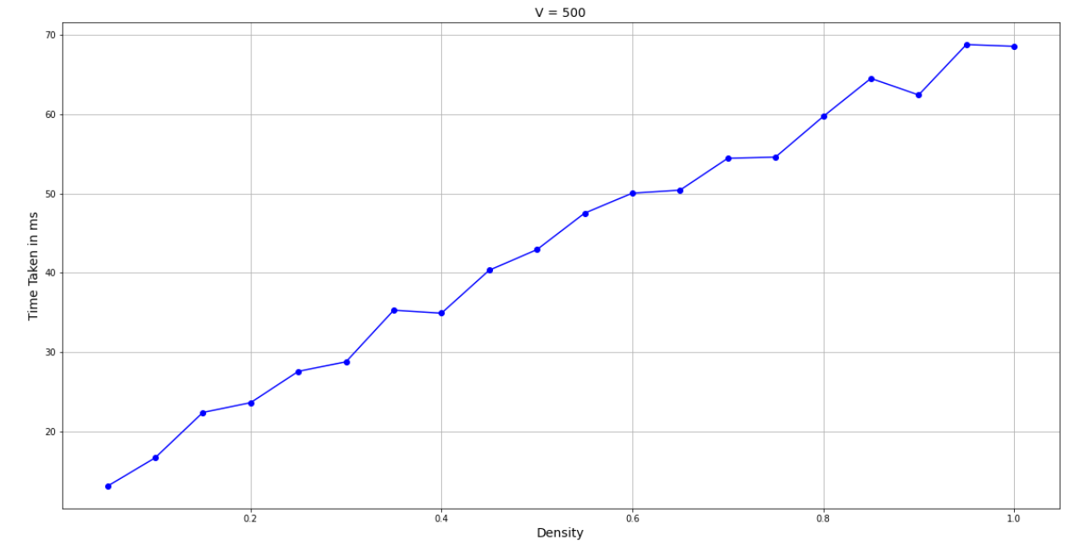
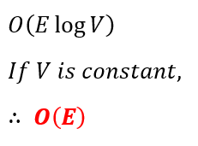
ANALYSIS I: DIFFERENT DENSITY WITH CONSTANT V
(ADJACENCY LIST)

Slide 17
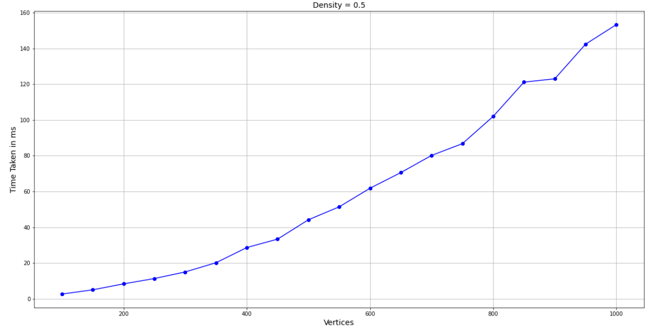
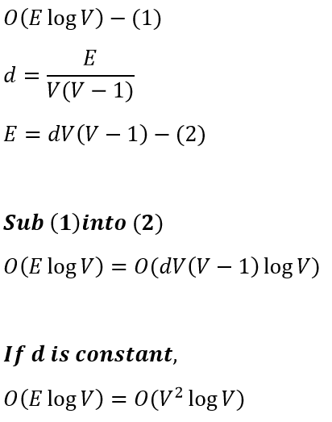
ANALYSIS II: CONSTANT DENSITY WITH DIFFERENT V
(ADJACENCY LIST)

Slide 18
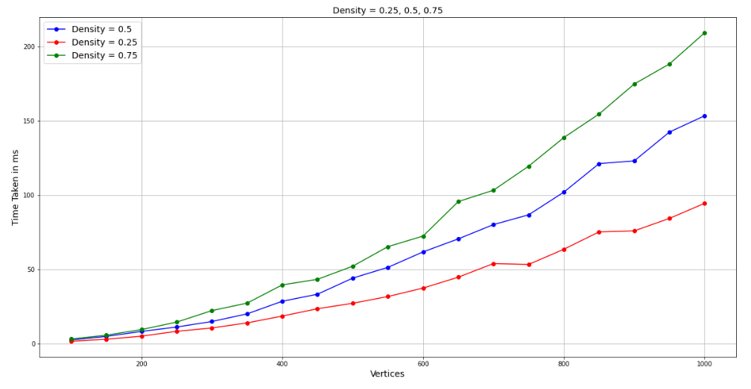
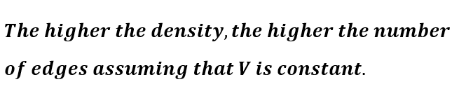
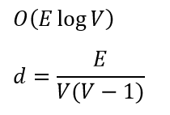
ANALYSIS III: DIFFERENT DENSITY AND V
(ADJACENCY LIST)

Slide 19
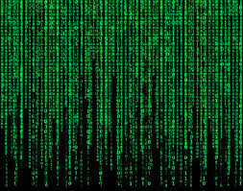

04
COMPARISON
(MATRIX VS LIST)

Slide 20
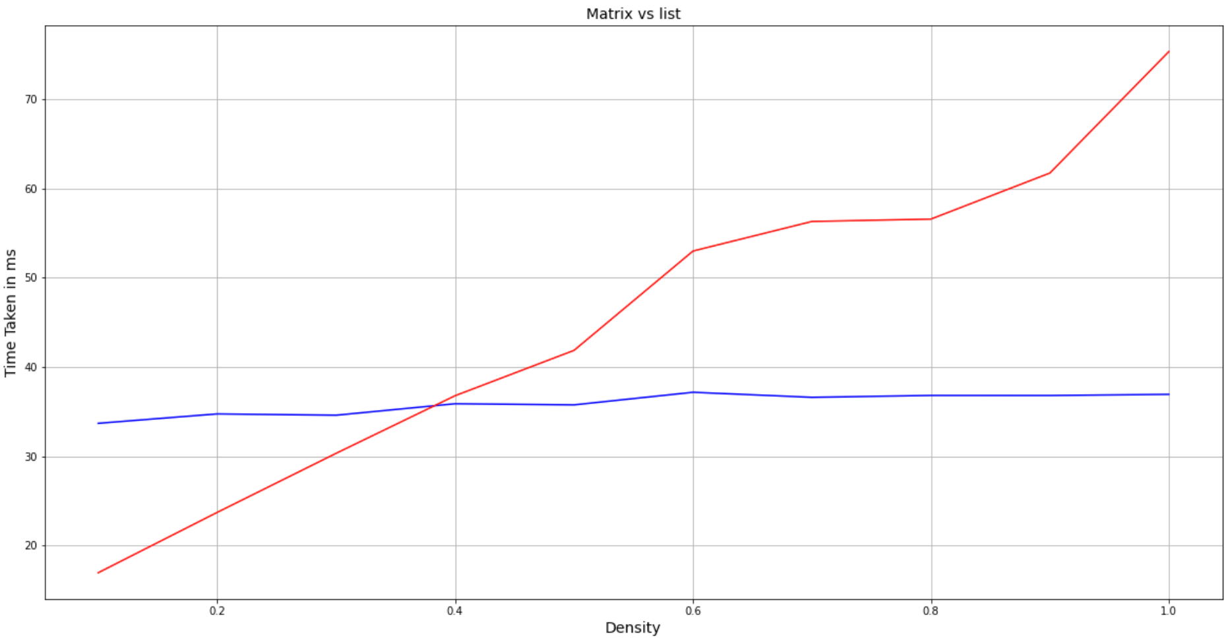
O(E*LogV)
O(V^2)

Slide 21
THANK YOU!

